Slide 1
Bootstrap
Bootstrap is the popular HTML, CSS and JavaScript framework for developing a responsive and mobile friendly website.

Slide 2
What is Bootstrap
Bootstrap is the most popular HTML, CSS and JavaScript framework for developing a responsive and mobile friendly website.
It is absolutely free to download and use.
It is a front-end framework used for easier and faster web development.
It includes HTML and CSS based design templates for typography, forms, buttons, tables, navigation, modals, image carousels and many others.
It can also use JavaScript plug-ins.
It facilitates you to create responsive designs.

Slide 3
History of Bootstrap
Bootstrap was developed by Mark Otto and Jacob Thornton at Twitter.It was released as an open source product in August 2011 on GitHub.
In June 2014 Bootstrap was the No.1 project on GitHub.

Slide 4
Why use Bootstrap
Following are the main advantage of Bootstrap:
It is very easy to use. Anybody having basic knowledge of HTML and CSS can use Bootstrap.
It facilitates users to develop a responsive website.
It is compatible on most of browsers like Chrome, Firefox, Internet Explorer, Safari and Opera etc.

Slide 5
What is a responsive website
A website is called responsive website which can
automatically adjust itself to look good on all
devices, from smart phones to desktops etc.

Slide 6
What Bootstrap package contains
Scaffolding: Bootstrap provides a basic structure with Grid System, link styles, and background.
CSS: Bootstrap comes with the feature of global CSS settings, fundamental HTML elements style and an advanced grid system.
Components: Bootstrap contains a lot of reusable components built to provide iconography, dropdowns, navigation, alerts, pop-overs, and much more.
JavaScript Plugins: Bootstrap also contains a lot of custom jQuery plugins. You can easily include them all, or one by one.
Customize: Bootstrap components are customizable and you can customize Bootstrap's components, LESS variables, and jQuery plugins to get your own style.

Slide 7
What is Bootstrap ?
It is the most popular HTML, CSS, JavaScript framework for developing responsive, mobile first websites.

Slide 8
Is Bootstrap Best?
Bootstrap is more than efficient to create a responsive and mobile first website but it is not the best in the industry. There is an alternative of Bootstrap named W3.CSS which is smaller, faster, and easier to use.

Slide 9
Bootstrap Example
Add the HTML 5 doctype: Bootstrap uses HTML elements and CSS properties, so you have to add the HTML 5 doctype at the beginning of the page with lang attribute and correct character set.
Ex:
<!DOCTYPE html>
<html lang="en">
<head><meta http-equiv="Content-Type" content="text/html; charset=windows-1252">
<title>Any title</title>
</head>
<body>
//write code
</body>
</html

Slide 10
Bootstrap for Mobile
Bootstrap is mobile friendly: Bootstrap is designed to be responsive to mobile devices.
Mobile-first styles are part of the core framework of Bootstrap.You have to add the following <meta> tag inside the <head> element for proper rendering and touch zooming:
<meta name="viewport" content="width=device-width, initial-scale=1">
Note: The "width=device-width" part is used to set the width of the page to follow the screen-width of the device (vary according to the devices).
The initial-scale=1 part is used to set the initial zoom level when the page is first loaded by the browser.
Containers: container is used to wrap the site contents. There are two container classes.
The .container class provides a responsive fixed width container.
The .container-fluid class provides a full width container, spanning the entire width of the viewport.

Slide 11
Bootstrap Container
Bootstrap, container is used to set the content's margins dealing with the responsive behaviors of your layout. It contains the row elements and the row elements are the container of columns (known as grid system).
The container class is used to create boxed content.
There are two container classes in Bootstrap:
container
container-fluid
.container has a max width pixel value, whereas .container-fluid is max-width 100%.
.container-fluid continuously resizes as you change the width of your window/browser by any amount.

Slide 12
Usage of Container
When using .container-fluid because the witdh is related to the viewport width the display is dynamic
Use .container-fluid when you want your page to shapeshift with every little difference in its viewport size.
Use .container when you want your page to shapeshift to only 5 kinds of sizes, which are also known as "breakpoints".

Slide 13
Bootstrap Jumbotron
A Bootstrap jumbotron specifies a big box for getting extra attention to some special content or information. It is displayed as a grey box with rounded corners. It can also enlarge the font sizes of the text inside it.
You can put any valid HTML or other Bootstrap elements/ classes inside a jumbotron.
The class .jumbotron within the <div> element is used to create a jumbotron.

Slide 14
Jumbotron
Jumbotron Inside Container
Jumbotron Outside Container
Full-width Jumbotron
Bootstrap Page Header

Slide 15
Bootstrap Buttons
Use the following classes to achieve the different button styles:
.btn-default
.btn-primary
.btn-success
.btn-info
.btn-warning
.btn-danger
.btn-link

Slide 16
Bootstrap Button Size
Bootstrap provides four button sizes.
The following classes define the different sizes:
.btn-lg
.btn-md
.btn-sm
.btn-xs

Slide 17
Bootstrap Grid
Grid is a structure (usually two-dimensional) made up of a series of intersecting straight (vertical, horizontal) lines used to structure the content. It is widely used to design layout and content structure in print design. In web design, it is a very effective method to create a consistent layout rapidly and effectively using HTML and CSS.“

Slide 18
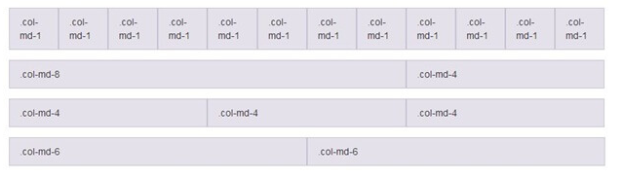
Bootstrap Grid System
The Bootstrap Grid System allows up to 12 columns across the page. You can use all 12 columns individually or you can groups the columns together to create wider columns.

Slide 19
Grid Classes:
There are four classes in Bootstrap Grid System:
xs (for phones)
sm (for tablets)
md (for desktops)
lg (for larger desktops)

Slide 20
Bootstrap Tables
Different types of Bootstrap tables by using different classes to style them.
Bootstrap Basic Table : The .table class is used to add basic styling to a table.
Bootstrap Striped Rows Table : The .table-striped class is used to add zebra-stripes to a table:
Bootstrap Bordered table : The .table-bordered class is used to add borders on all sides of the table and cells:
Bootstrap Hover rows Table:The .table-hover class is used to enable a hover state on table rows:
Bootstrap Condensed table:
The .table-condensed class is used to make a table more compact by cutting cell padding in half:
Bootstrap Contextual classes :
Contextual classes are used to color table rows (<tr>) or table cells (<td>):

Slide 21
Bootstrap Forms
Three types of form layouts:
Vertical form (this is default)
Horizontal form
Inline form
Bootstrap Form Rules
There are three standard rules for these 3 form layouts:
Always use <form role="form"> (helps improve accessibility for people using screen readers)
Wrap labels and form controls in <div class="form-group"> (needed for optimum spacing)
Add class .form-control to all textual <input>, <textarea>, and <select> elements

Slide 22
Bootstrap Alerts
Bootstrap Alerts are used to provide an easy way to create predefined alert messages. Alert adds a style to your messages to make it more appealing to the users.
There are four classes that are used within <div> element for alerts.
.alert-success
.alert-info
.alert-warning
.alert-danger

Slide 23
Bootstrap Panels
Bootstrap, a panel is a bordered box with some padding around its element. The panel components are used when you want to put your DOM component in a box.
The class .panel is used within the <div> element to create Bootstrap panels. The content inside the panel has a .panel-body class.
Generally a panel contains three parts:
Panel header
Panel content
Panel footer

Slide 24
Bootstrap Progress Bar
The progress bar shows how far a user is in a process. In Bootstrap, there are several types of progress bars.
The class .progress within a <div> element is used to create a default progress bar in bootstrap.

Slide 25
Bootstrap List Groups
Bootstrap list group is used to create a group of list with list items. The most basic list group is an unordered list containing list items.
The class ".list-group" within the <ul> element and the class ".list-group-item" within the <li>element are used to create a basic list group.

Slide 26
Bootstrap Dropdowns
Dropdown menus are toggleable, contextual menus, used for displaying links in a list format. It facilitates users to choose one value from a predefined list. This can be made interactive with the dropdown JavaScript plugin.
You have to wrap dropdown menu within the class .dropdown to create Bootstrap Dropdown.

Slide 27
Button Groups
Bootstrap 5 allows you to group a series of buttons together (on a single line) in a button group
Vertical Button Groups
Bootstrap 5 also supports vertical button groups:
Use the class .btn-group-vertical to create a vertical button group:

Slide 28
Bootstrap 5 Badges
Badges are used to add additional information to any content
Use the .badge class together with a contextual class (like .bg-secondary) within <span> elements to create rectangular badges. Note that badges scale to match the size of the parent element (if any)
Contextual Badges
Use any of the contextual classes (.bg-*) to change the color of a badge
Pill Badges
Use the .rounded-pill class to make the badges more round
Definition and Usage of h tag
The <h1> to <h6> tags are used to define HTML headings.
<h1> defines the most important heading. <h6> defines the least important heading.
Note: Only use one <h1> per page - this should represent the main heading/subject for the whole page. Also, do not skip heading levels - start with <h1>, then use <h2>, and so on.

Slide 29
Bootstrap 5 Spinners
Spinners
To create a spinner/loader, use the .spinner-border class
Colored Spinners
Use any text color utilites to add a color to the spinner:

Slide 30
Bootstrap 5 Cards
Cards
A card in Bootstrap 5 is a bordered box with some padding around its content. It includes options for headers, footers, content, colors, etc.
Basic Card
A basic card is created with the .card class, and content inside the card has a .card-body class.
Header and Footer
The .card-header class adds a heading to the card and the .card-footer class adds a footer to the card
Contextual Cards
To add a background color the card, use contextual classes (.bg-primary, .bg-success, .bg-info, .bg-warning, .bg-danger, .bg-secondary, .bg-dark and .bg-light.

Slide 31
Bootstrap 5 Navs
Nav Menus
If you want to create a simple horizontal menu, add the .nav class to a <ul> element, followed
by .nav-item for each <li> and add the .nav-link class to their links
Aligned Nav
Add the .justify-content-center class to center the nav, and the .justify-content-end class to right-align the nav.
Vertical Nav
Add the .flex-column class to create a vertical nav
Tabs
Turn the nav menu into navigation tabs with the .nav-tabs class. Add the .active class to the active/current link.

Slide 32
Bootstrap 5 Navbars
Navigation Bars
A navigation bar is a navigation header that is placed at the top of the page
Basic Navbar
A standard navigation bar is created with the .navbar class, followed by a responsive collapsing class: .navbar-expand-xxl|xl|lg|md|sm (stacks the navbar vertically on xxlarge, extra large, large, medium or small screens).
To add links inside the navbar, use either an <ul> element (or a <div>) with class="navbar-nav". Then add <li> elements with a .nav-item class followed by an <a> element with a .nav-link class
Vertical Navbar
Remove the .navbar-expand-* class to create a navigation bar that will always be vertical
Centered Navbar
Add the .justify-content-center class to center the navigation bar
Colored Navbar
Use any of the .bg-color classes to change the background color of the navbar (.bg-primary, .bg-success, .bg-info, .bg-warning, .bg-danger, .bg-secondary, .bg-dark and .bg-light)

Slide 33
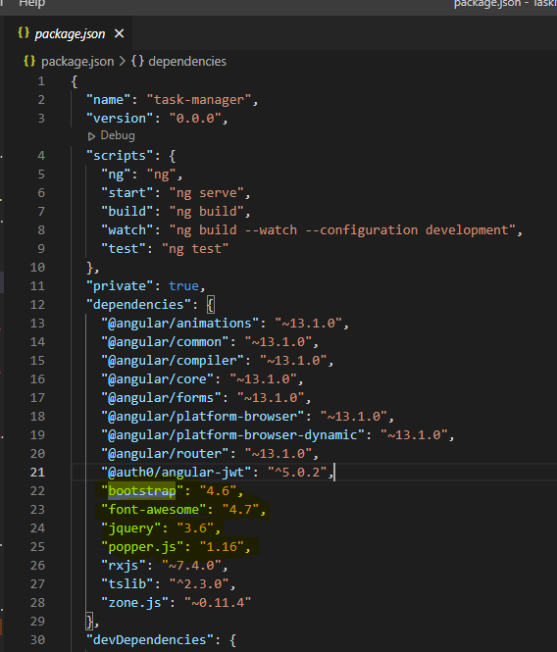
How to add bootstrap in Angular

Slide 34
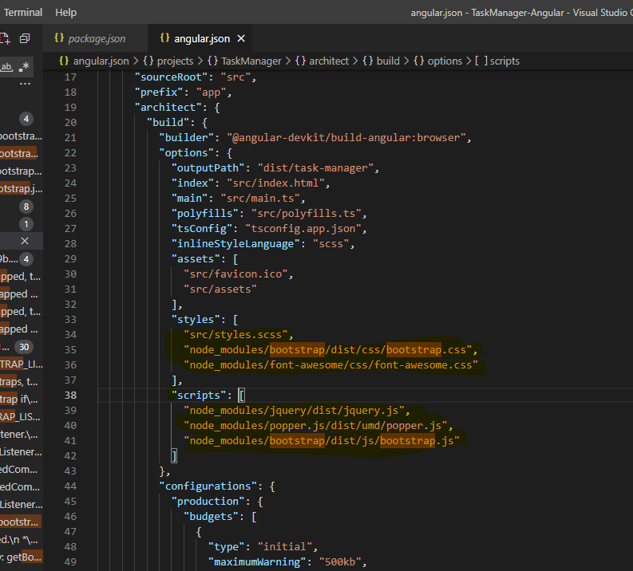

Slide 35
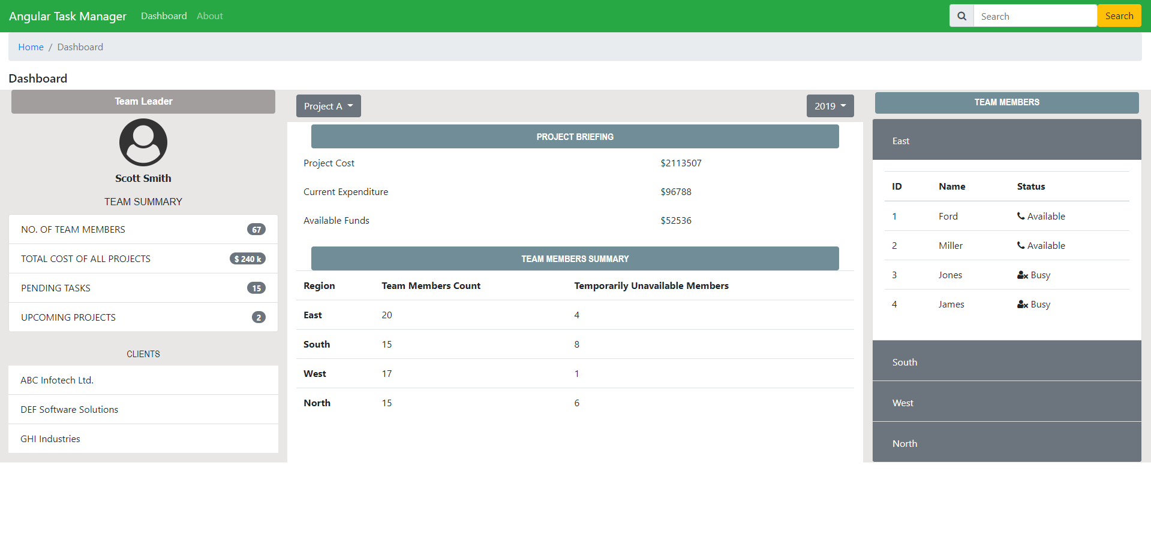
Design

Slide 36
THANK YOU

